Slide 1
-5 to 5

Slide 2
Why are you doing this?

Slide 4
Arguing to 100

Slide 5
Observation: Every conversation has a moral framework
lowest evil
highest good

Slide 6
Example: Trump’s redefinition of 100 and -100 in American politics
Inequality
Equality
Before
American decline
American greatness
After

Slide 7
Example: Jobs’s redefinition of 100 and -100 in computing
Unintelligible
(low sophistication)
Unintelligible
(high sophistication)
Before
Unusably complex
Empowering everyone with
simplicity plus power
After

Slide 8
Example: MLK’s redefinition of 100 and -100 in race relations
Before
Not a big enough issue
Judged by color
of skin
Judged by content of
character (colorblind society)
After

Slide 9
Example: The green movement’s redefinition of 100 and -100 in energy
Unavailability or
insecurity
Availability or
security
Before
Not green/renewable
(more fossil fuels)
Completely
green/renewable
After

Slide 10
“Transition”/ extinction narrative
Humanity should and likely will radically reduce fossil fuel use because it
(1) Causes climate change (2) Is replaceable by renewables

Slide 11
Arguing to 0

Slide 12
Bad persuaders accept their opponents’ definition of good and evil—even though they don’t agree with it.
1. Accept the goal (100)
Not green/renewable
(more fossil fuels)
Completely
green/renewable
2. Argue superiority of product or policy
More fossil fuel
development, fracking
Solar and wind subsidies,
Green New Deal

Slide 13
But this forces them into a disastrous position.
Example: Shale energy
Not green/renewable
(more fossil fuels)
Completely
green/renewable

Slide 14
“Transition”/ extinction narrative
Executives report this narrative is causing problems with stakeholders including:
Investors
Board members
Employees
Communities
Voters

Slide 15
Challenging and changing 100

Slide 18
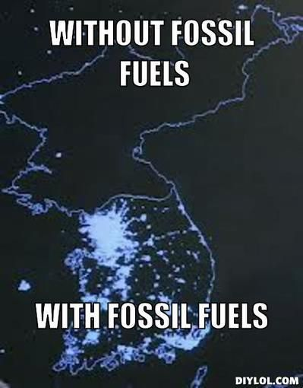

Slide 19
My definition of 100 and -100 in energy (and everything else)
Maximum
Human Suffering
Maximum
Human Flourishing

Slide 20
Maximum human flourishing is the “ultimate 100,” which includes many other (derivative) 100s covering every population level (global, national, local) and every crucial value issue, including:
Prosperity
Opportunity
Health
Environmental quality
Climate safety
The future

Slide 21
The Moral Case for Fossil Fuels

Slide 22
High level argument to 100
The best energy policy is the one with the best overall impact on human life now and in the future.
The benefits of fossil fuels to human life over the next several decades far, far exceed the costs.
The only ethical and practical way to reduce global CO₂ levels is through innovations that make low-carbon energy cheap, plentiful, and reliable.

Slide 23
1
The best policy is the one with the best overall impact on human life now and in the future.

Slide 24
Energy is the industry that powers every other industry.

Slide 25
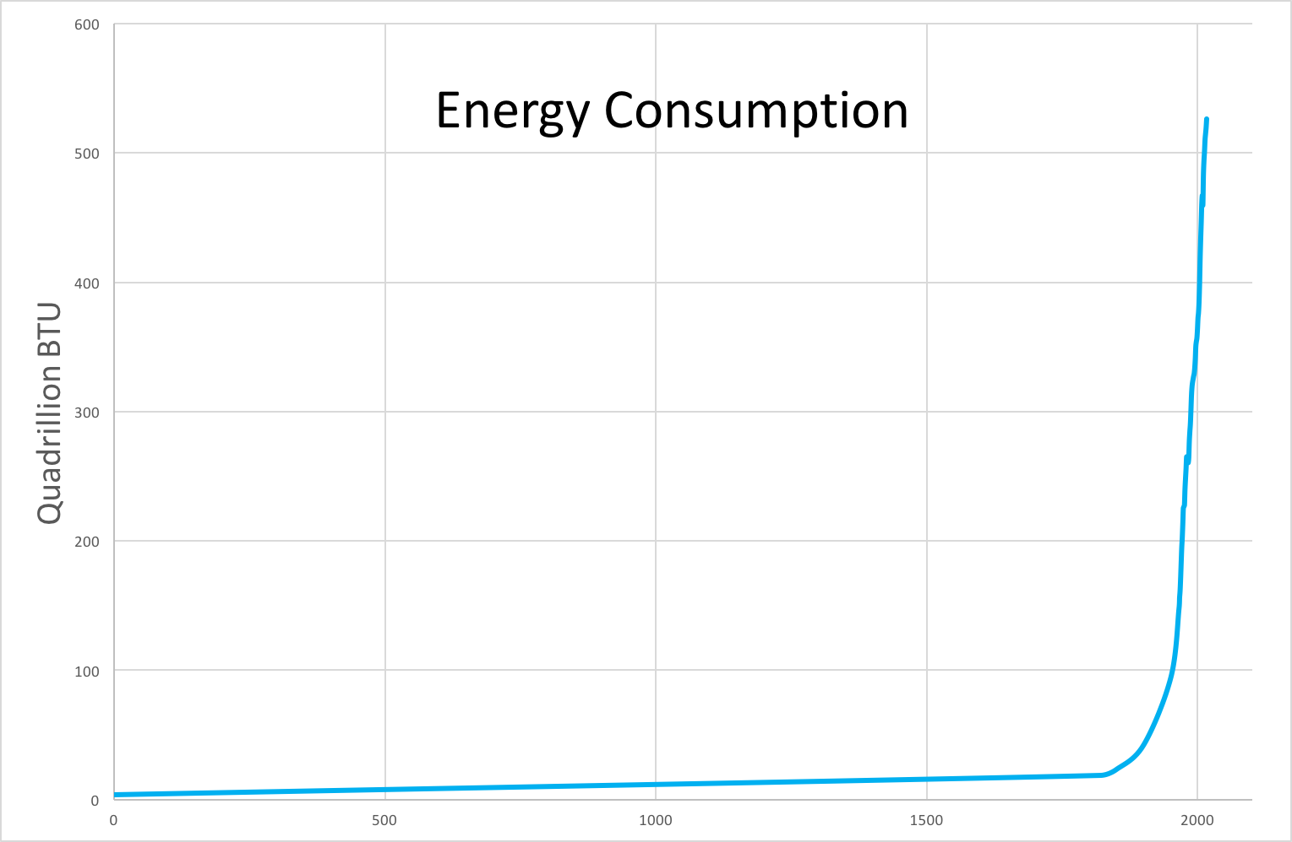
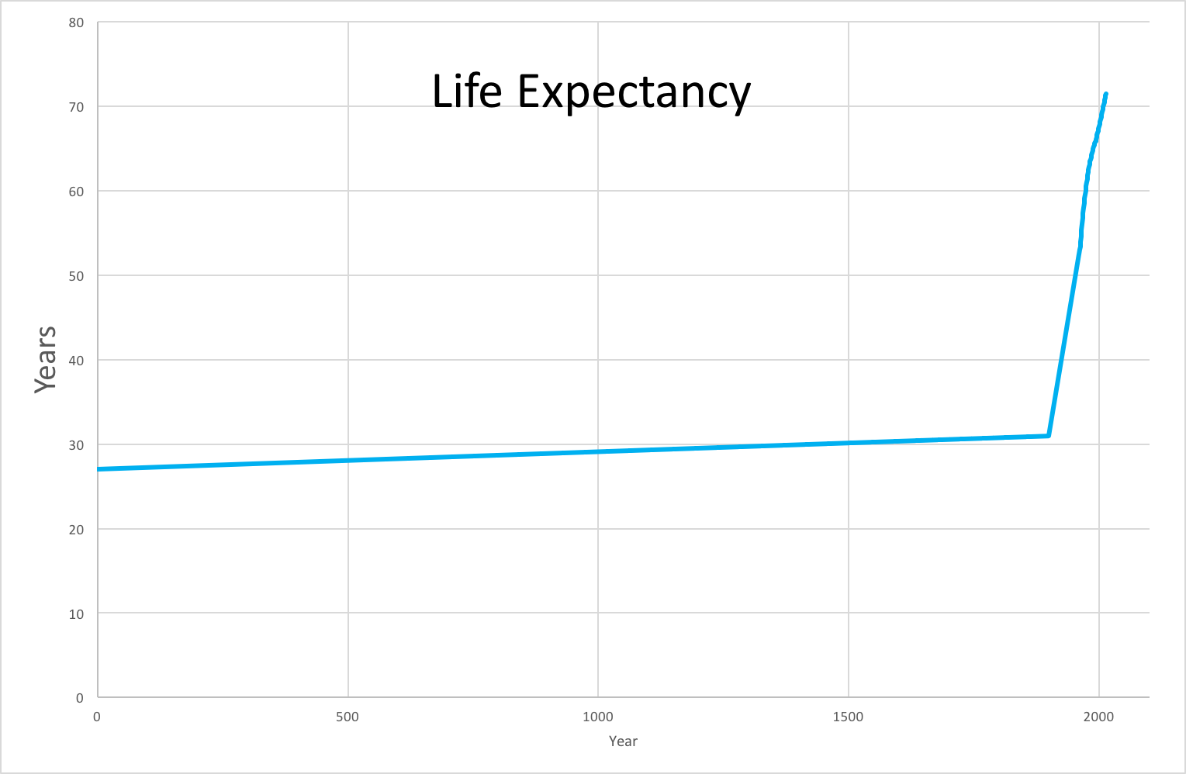
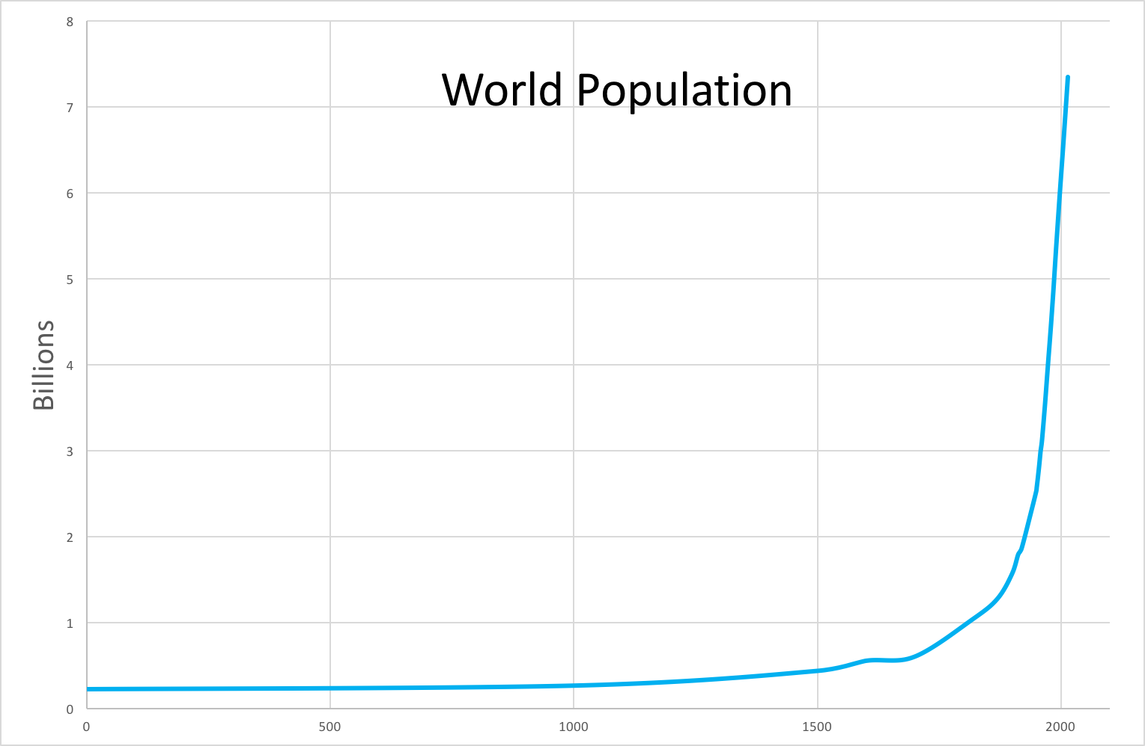
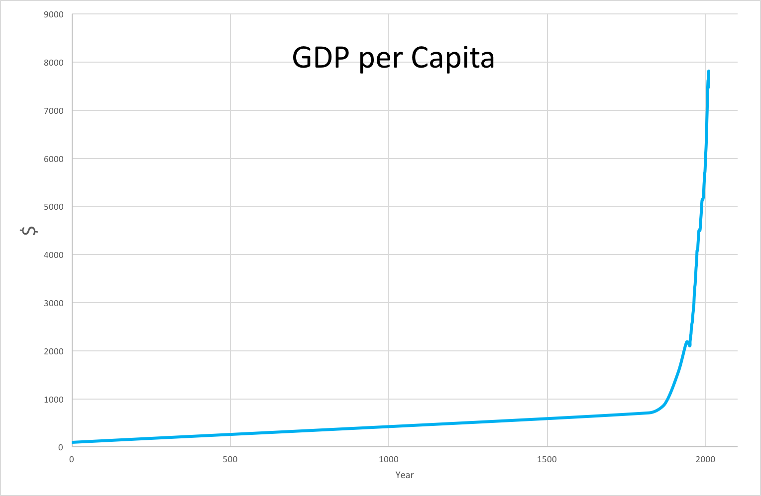
The more cheap, plentiful, and reliable energy is, the more cheap, plentiful, and reliable everything is

Slide 26
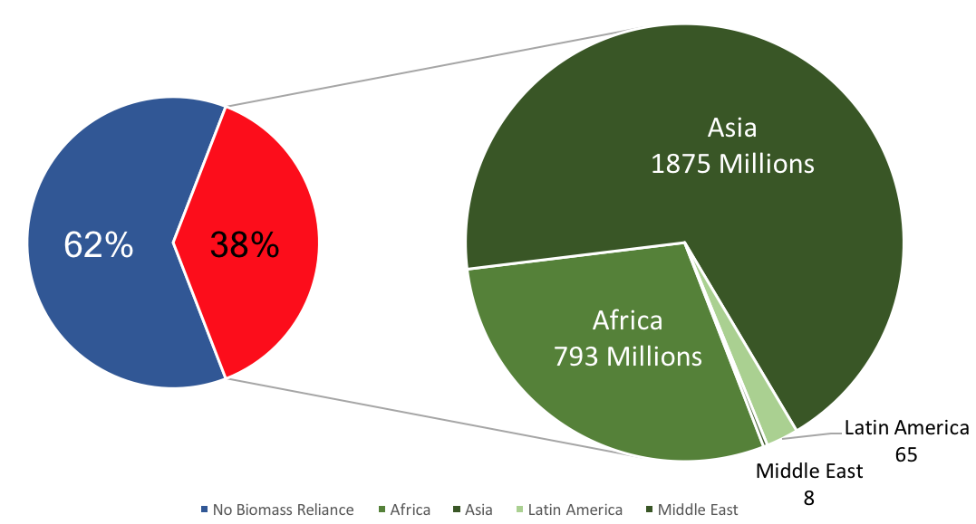
3 billion people today lack access to plentiful, reliable energy

Slide 27
Cheap, plentiful, reliable energy is fundamental to human flourishing, including prosperity, environmental quality, and climate safety.

Slide 28
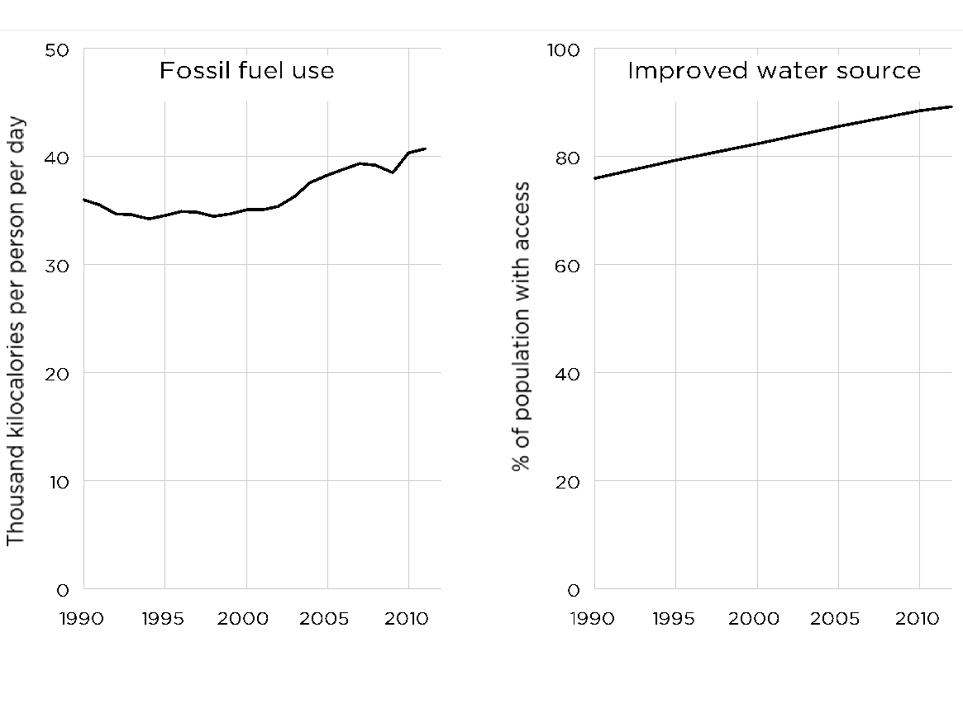
Nature doesn’t give us a clean environment we make dirty, it gives us a dirty environment we need to make clean

Slide 29
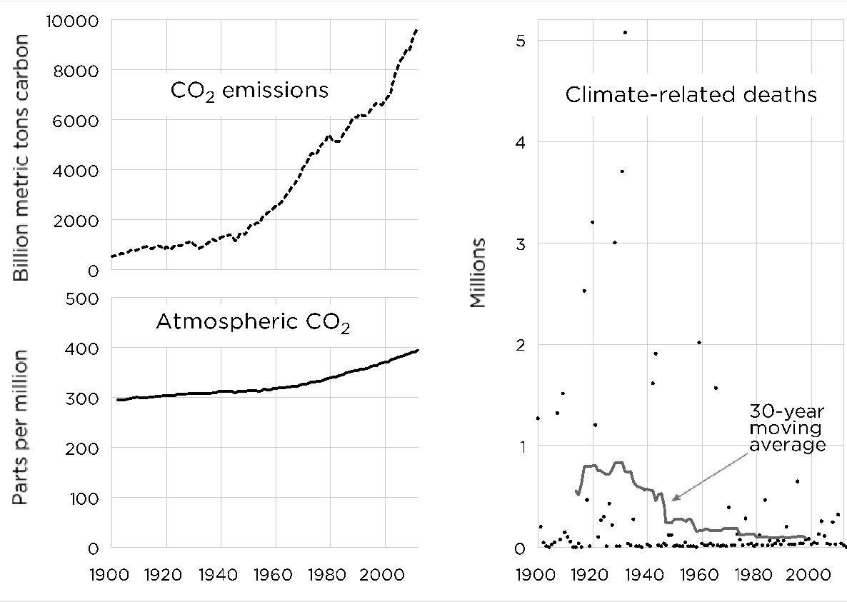
Nature doesn’t give us a safe climate that we make dangerous, it gives us a dangerous climate that we need to make safe

Slide 30
2
The benefits of fossil fuels to human life over the next several decades far, far exceed the costs.

Slide 31
We need to look at all the benefits and costs of all forms of energy; we can’t just look at the benefits of solar and wind and the costs of fossil fuels and nuclear.

Slide 32
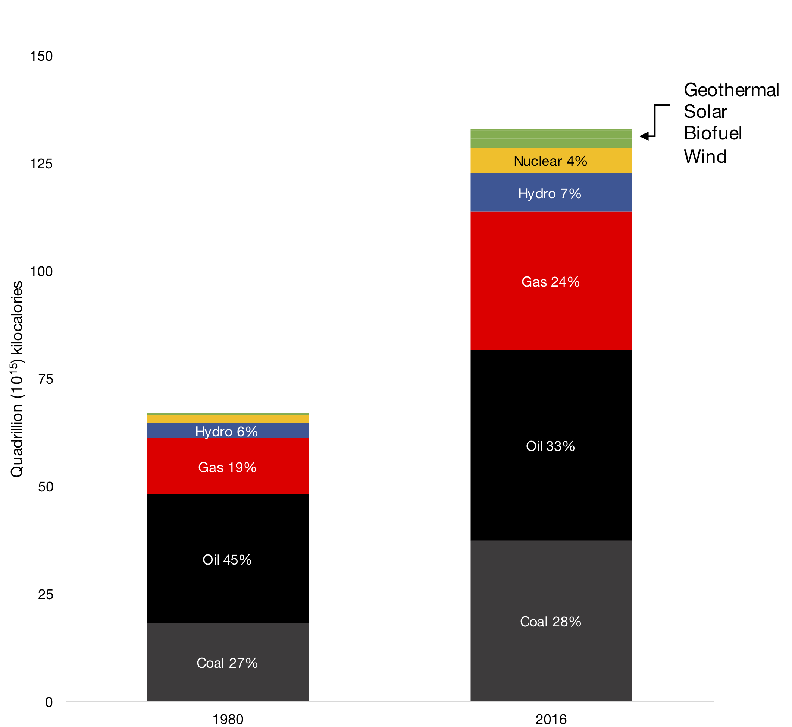
The fossil fuel industry is the only industry that can provide cheap, plentiful reliable energy to the billions of people who have energy and the billions of people who don’t

Slide 33
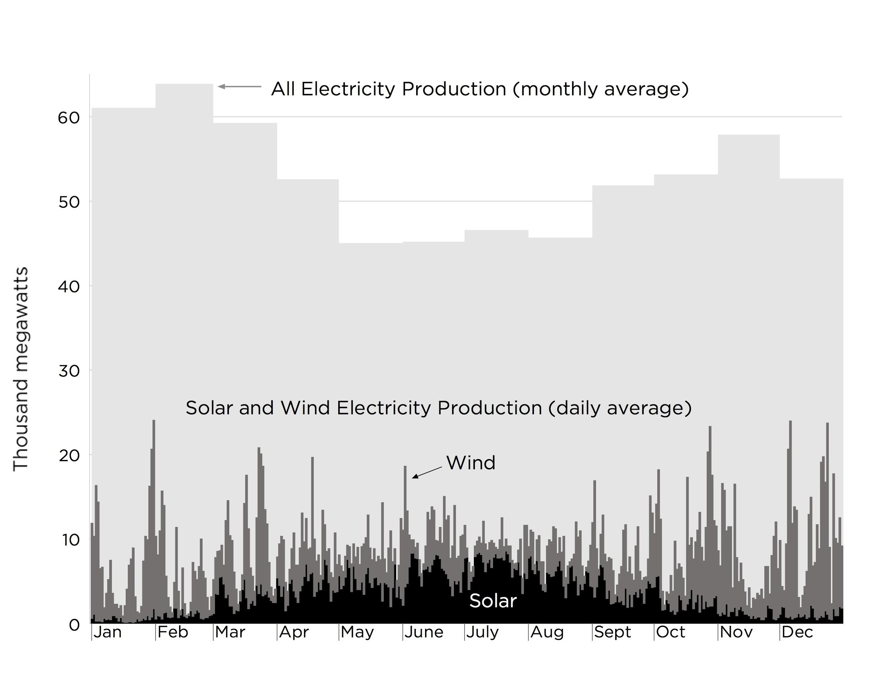
Solar and wind power are “unreliables” that need constant life support from reliable fuels such as coal, gas, and uranium

Slide 34
3
The only ethical and practical way to reduce global CO₂ levels is through innovations that make low-carbon energy cheap, plentiful, and reliable.

Slide 35
Radical reductions in fossil fuel use in the coming decades would sentence billions to poverty, including low environmental quality and high climate danger.

Slide 36
“The Green New Deal” would actually be a “Green Depression.”

Slide 37
The number one policy governments around the world should follow to reduce CO₂ emissions is to decriminalize nuclear power.

Slide 38
Arguing to 100 works. So stop arguing to 0.

Slide 39
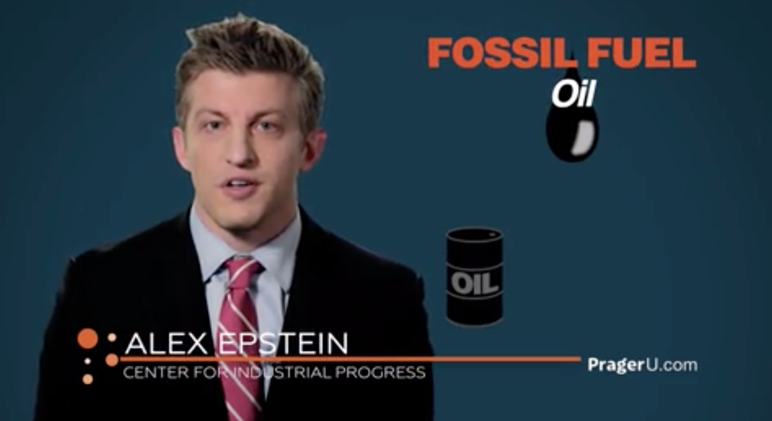

Slide 40
Turning non-supporters into supporters
“
I saw you speak in the University of Minnesota in 2009, and I HECKLED YOU! That’s right, I used to be an eco-activist Occupy protester anti-industrialist. Now after 5 years of studying to find the truth, I am a supporter! I have a YouTube channel, I self-publish books, and I arrange small group discussions over movies or topics in the ‘environmentalist’ movement and with entrepreneurs. It’s important people are aware of their actions as they vote & lobby to kill the one industry that has given us a better quality of life.” –Anonymous
“
Alex, I have always considered myself both an environmentalist and a skeptic, and I want to thank you for 1) changing my mind regarding fossil fuels, and 2) reminding me that I am a skeptic first and foremost.” –Dylan, Harvard University

Slide 41
Feel confident in my ability to turn non-supporters of the fossil fuel industry into supporters

Slide 42
Eager to champion the fossil fuel industry

Slide 43
Understand the positive impacts of the fossil fuel industry on our environment

Slide 44
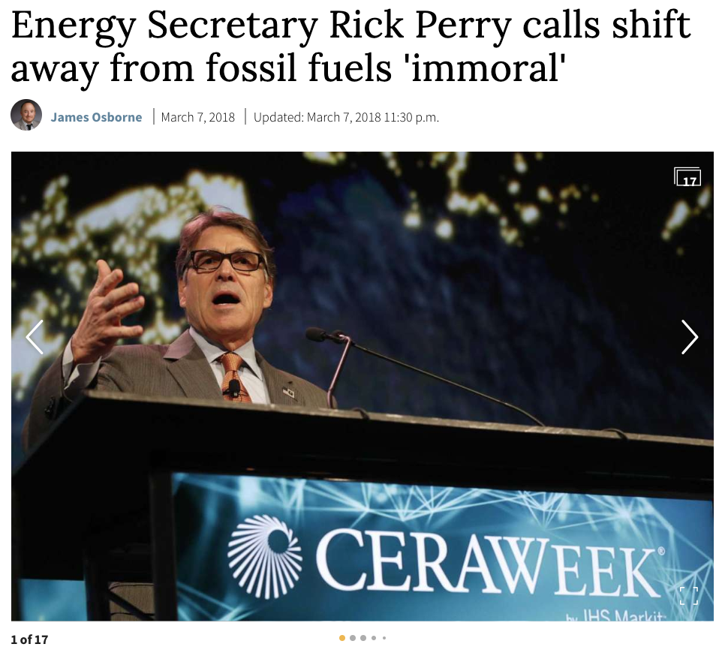
Notes:
https://canadians.org/content/world-future-council-statement-against-nuclear-power
https://www.nytimes.com/2011/03/19/opinion/19herbert.html

Slide 45
3 takeaways
1
The extinction narrative is an existential threat
2
Arguing to 0 doesn’t work and isn’t honest
3
Arguing to 100 does work and is honest

Slide 46
Key stakeholders
Investors
Board members
Employees
Communities
Voters

Slide 48
I want to see
Employees arguing to 100
Lobbyists arguing to 100
Executives arguing to 100
Politicians arguing to 100

Slide 49
“What next?”
Send me an email or hand me a business card. alex@alexepstein.com
I’ll follow up about:
Weekly email list: If you want you and your team to have arguments to 100 on new issues (plus a 30 part Energy Clarity course)
Speaking: If you want a great speaker to change the narrative to a key stakeholder group
Messaging solutions: If you want us to help create your messaging
Champion: If you want to get personally involved in championing energy abundance and are willing to commit 1 hour a month

